Slide 1
Reusable Pods for Interplanetary Travel System
From Earth to Beyond — One Pod, Many Possibilities

Slide 2



MEET OUR TEAM
SRIRAM REPAKA
VANDANA CHEGONDI
NAGA SAI VAMSI UPPULURI

Slide 3
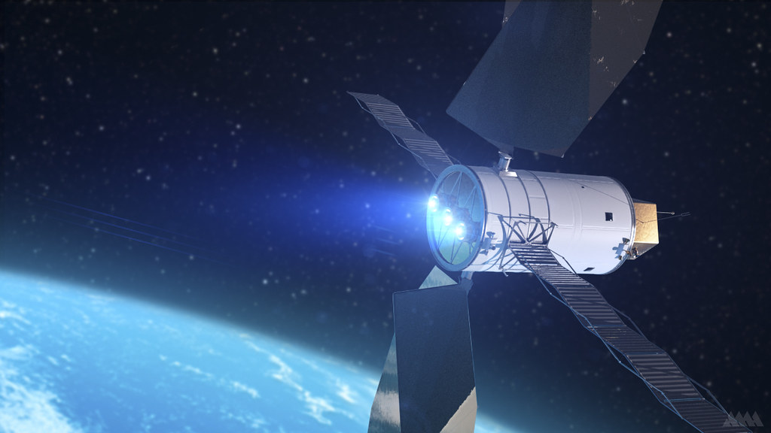
Contents
Background & Motivation
Pods: ITS Extension and More
Business Model & Key Activities
Value Proposition & Customer Relations
Financial Overview (Cost Structure & Revenue Streams)
Timeline, Trade-offs & Phases
Technical Design & Key Concepts
Conclusion

Slide 4

Background & Motivation
Although ITS helps with space travel, it has its own limitations.
Limited crew capacity
Complexity
Costs
Customization based on mission use cases
Space travel is evolving rapidly with increasing demand for sustainable transport.

Slide 5
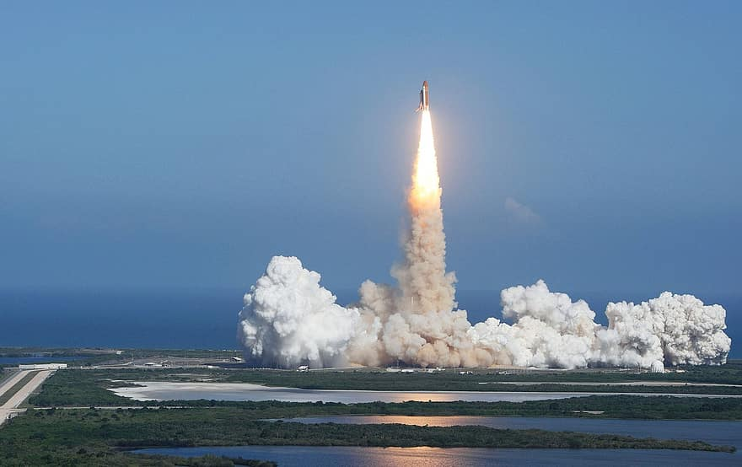
Compact, modular pods designed to integrate seamlessly with the ITS infrastructure.
Enable customized mission profiles — from cargo to crewed missions
PODS: ITS Extension and More
Enhance passenger safety with advanced shielding, autonomous control.
Overall mission costs with reusable pod design will be reduced.

Slide 6
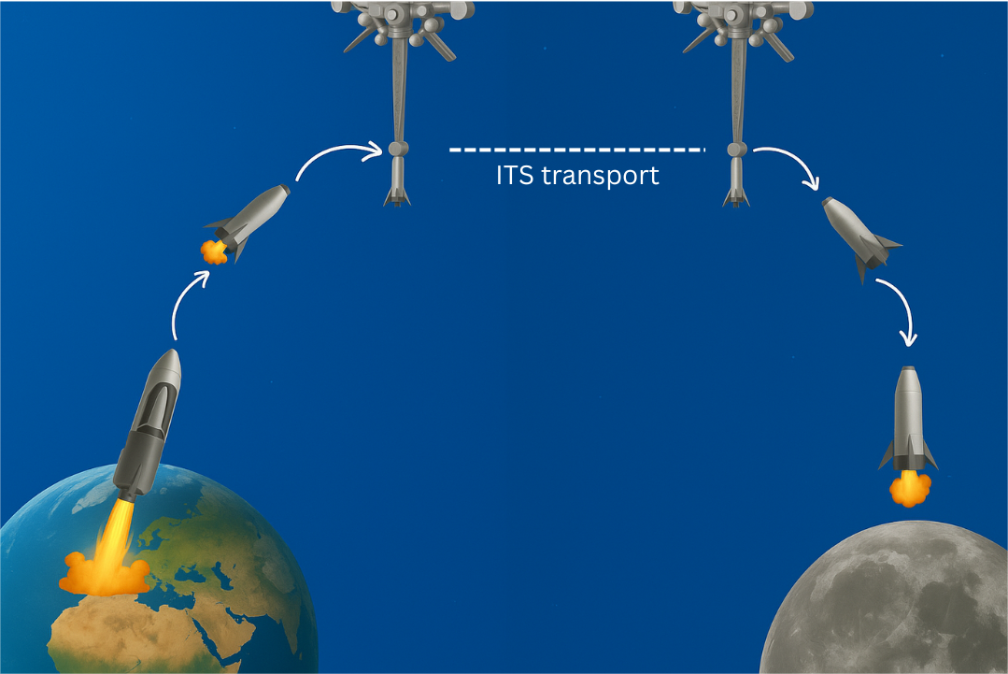
Mission Profile

Slide 7
Pod design
Feature | Our Pods
Reusability | Fully/Semi-reusable after each mission
Mission Type | Crew, cargo for research establishments, or crew + cargo hybrid
Design Philosophy | Modular, customizable per mission/user
Cost Structure | Lower cost through reuse and leasing model
Users | Governments, research labs, universities, commercial users
Launch Rate | Scalable – fleet deployment and frequent missions
Business Model | Subscription/leasing + technical support services
Post-Mission | Refurbished and redeployed

Slide 8
Cargo
Transport
Crew Missions
USE CASES
Space Tourism
Research Labs
Planetary Resupply

Slide 9






Customer Segments & Key Partners
Research and Other Institutions
Private Space Agencies
Government Space Agencies
Independent Customers

Slide 10





Mission-Critical Resources
Aerospace engineers and scientists to design, build, and test reusable pods.
Funding and Capital Access
Advanced Materials
Space-grade metals (e.g., titanium)
R&D Infrastructure
Access to wind tunnels, and thermal testing facilities (e.g., via MIT, IISc).
Simulation and Design Tools
SolidWorks for 3D modeling and virtual stress analysis.

Slide 11
Core Operational Activities
Develop MRO systems to ensure pods can be serviced and reused safely.
System integration with ITS. Engineering and software coordination comes into life.
Design & Manufacturing
Prototyping & Testing
Research & Development
Innovate lightweight structures, radiation protection, and hybrid cargo and crew systems with university collaboration.
Aerospace-grade manufacturers in global hubs (California, Toulouse, Bangalore).
Small-scale 3D-printed models using real aerospace materials.
Maintenance & Reusability
System Integration

Slide 12





Value Proposition
Multi-Purpose Configuration
1
2
3
4
5
Reusability = Cost Savings
1. Multiple missions
Multi-Purpose Configuration
1. Flexible for Cargo, crew and Hybrid
Engineered for Harsh Environments
1. Safe
2. Durable
3. Lightweight
Accessible & Affordable
1. Scalability
2. Affordability
Seamless ITS Integration
1. Fully compatible

Slide 13
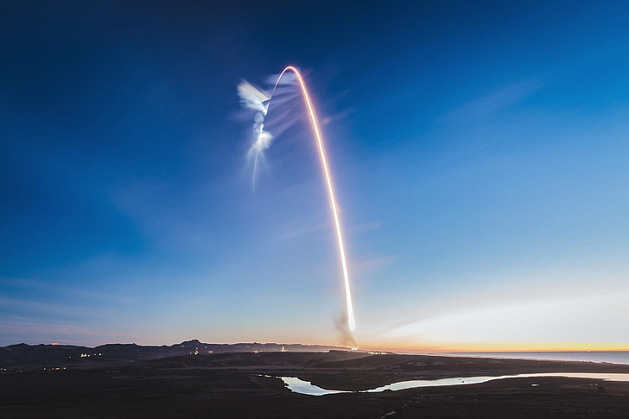




Materials & Components
Manufacturing Setup
Mission Cost Breakdown
R&D & Prototyping
Salaries

Slide 14
Revenue Streams
1
2
3
4
5
Government Contracts
Advertising
Media
Research Payload Delivery
Pod & ITS Leasing
Specialized Payload Services

Slide 15




Cost vs. Reusability
Speed to Market vs. Technological Reliability
Trade-off
Government Collaboration vs. Independence
Weight vs. Safety

Slide 16





2026
2027
Ideation & Feasibility
Define mission scope (cargo/crew, orbit, duration)
Market and competitor analysis
Initial concept sketches & simulations
Team building + funding proposals
High-level trade-off studies
Final Pod Build & Certification
Finalize reusable pod architecture
QA, fault-tolerance & redundancy validation
Work with certifying bodies (NASA, ESA, ISRO)
Run full simulations & emergency response tests
Conceptual Design & Prototyping
Subsystem architecture: propulsion, life support.
CAD modelling & materials R&D (e.g., carbon composites)
Build Alpha (non-functional or partially functional) prototype
Partnership building with agencies & research institutions
Full System Integration & Testing
Build Beta prototype (functionally complete)
Subsystem integration (navigation, docking, safety systems)
Extensive environmental tests: vacuum, vibration, thermal cycles
Simulated space missions and automated docking trials
Launch Readiness & Deployment
Pre-launch procedures and dry runs
Orbital or suborbital mission launch
Begin commercialization or government partnerships
Plan for next-gen pod upgrade (modular systems, planetary landing)
TIMELINE & PHASES
2028
2029
2030

Slide 17
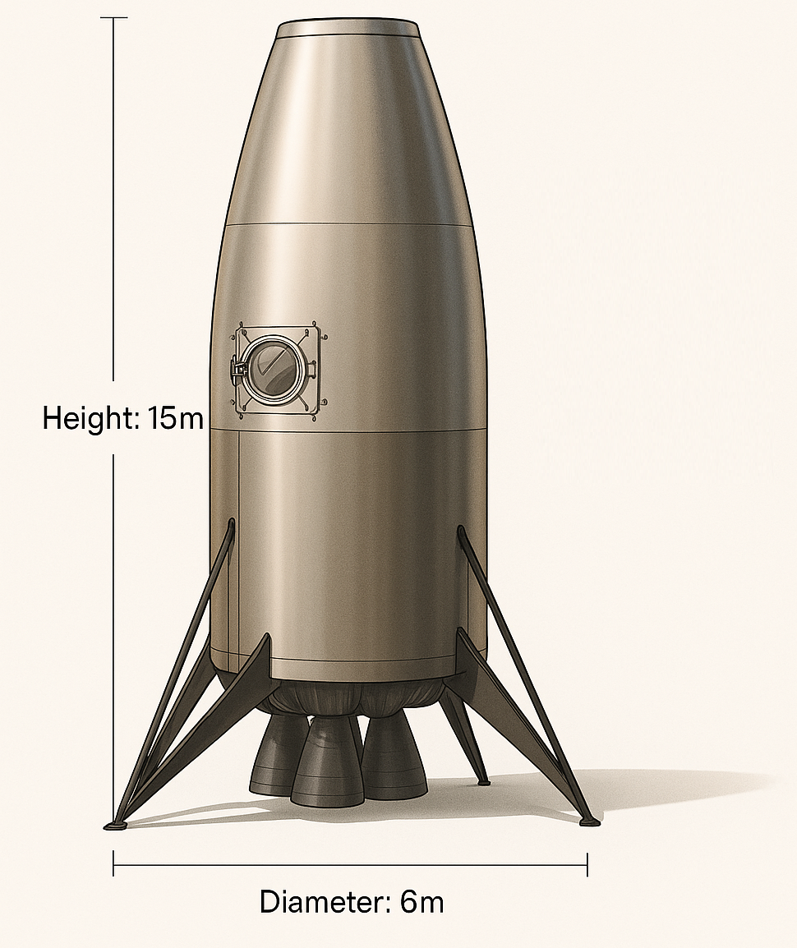
POD DESIGN OVERVIEW AND DIMENSIONS
Lunar mission (Modular, Human rated and transitional element, Autonomous )
ITS-Compatible Structure(Universal tophatch, Umbilical)
15m Height × 6m Diameter (Cylindrical profile, Circular decks)
9.5m Habitable Volume (200 m³)
Supports 6 Crew (≥25 m³/person)
~31.3 Tons Habitat Mass
Designed for Pressurization & Radiation Shielding
Figure : Pod Exterior model

Slide 18
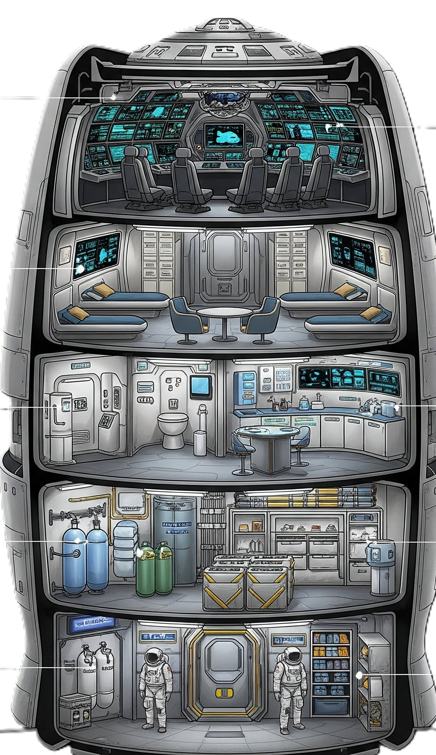
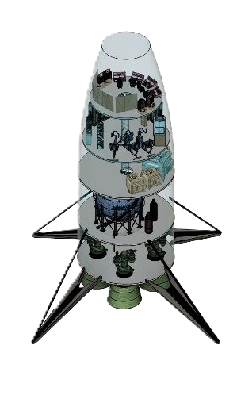
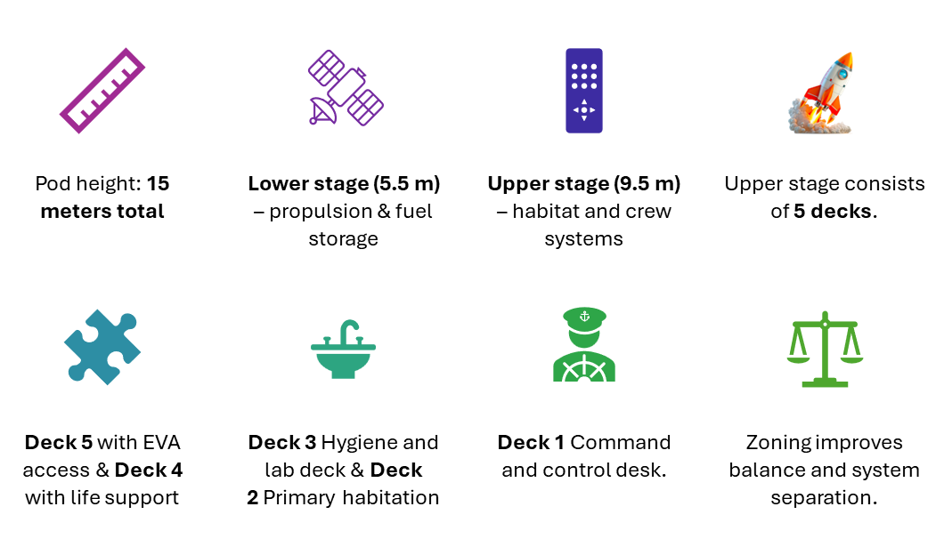
INTERNAL LAYOUT AND FUNCTIONAL ZONING
Figure : Pod Interior design model

Slide 19
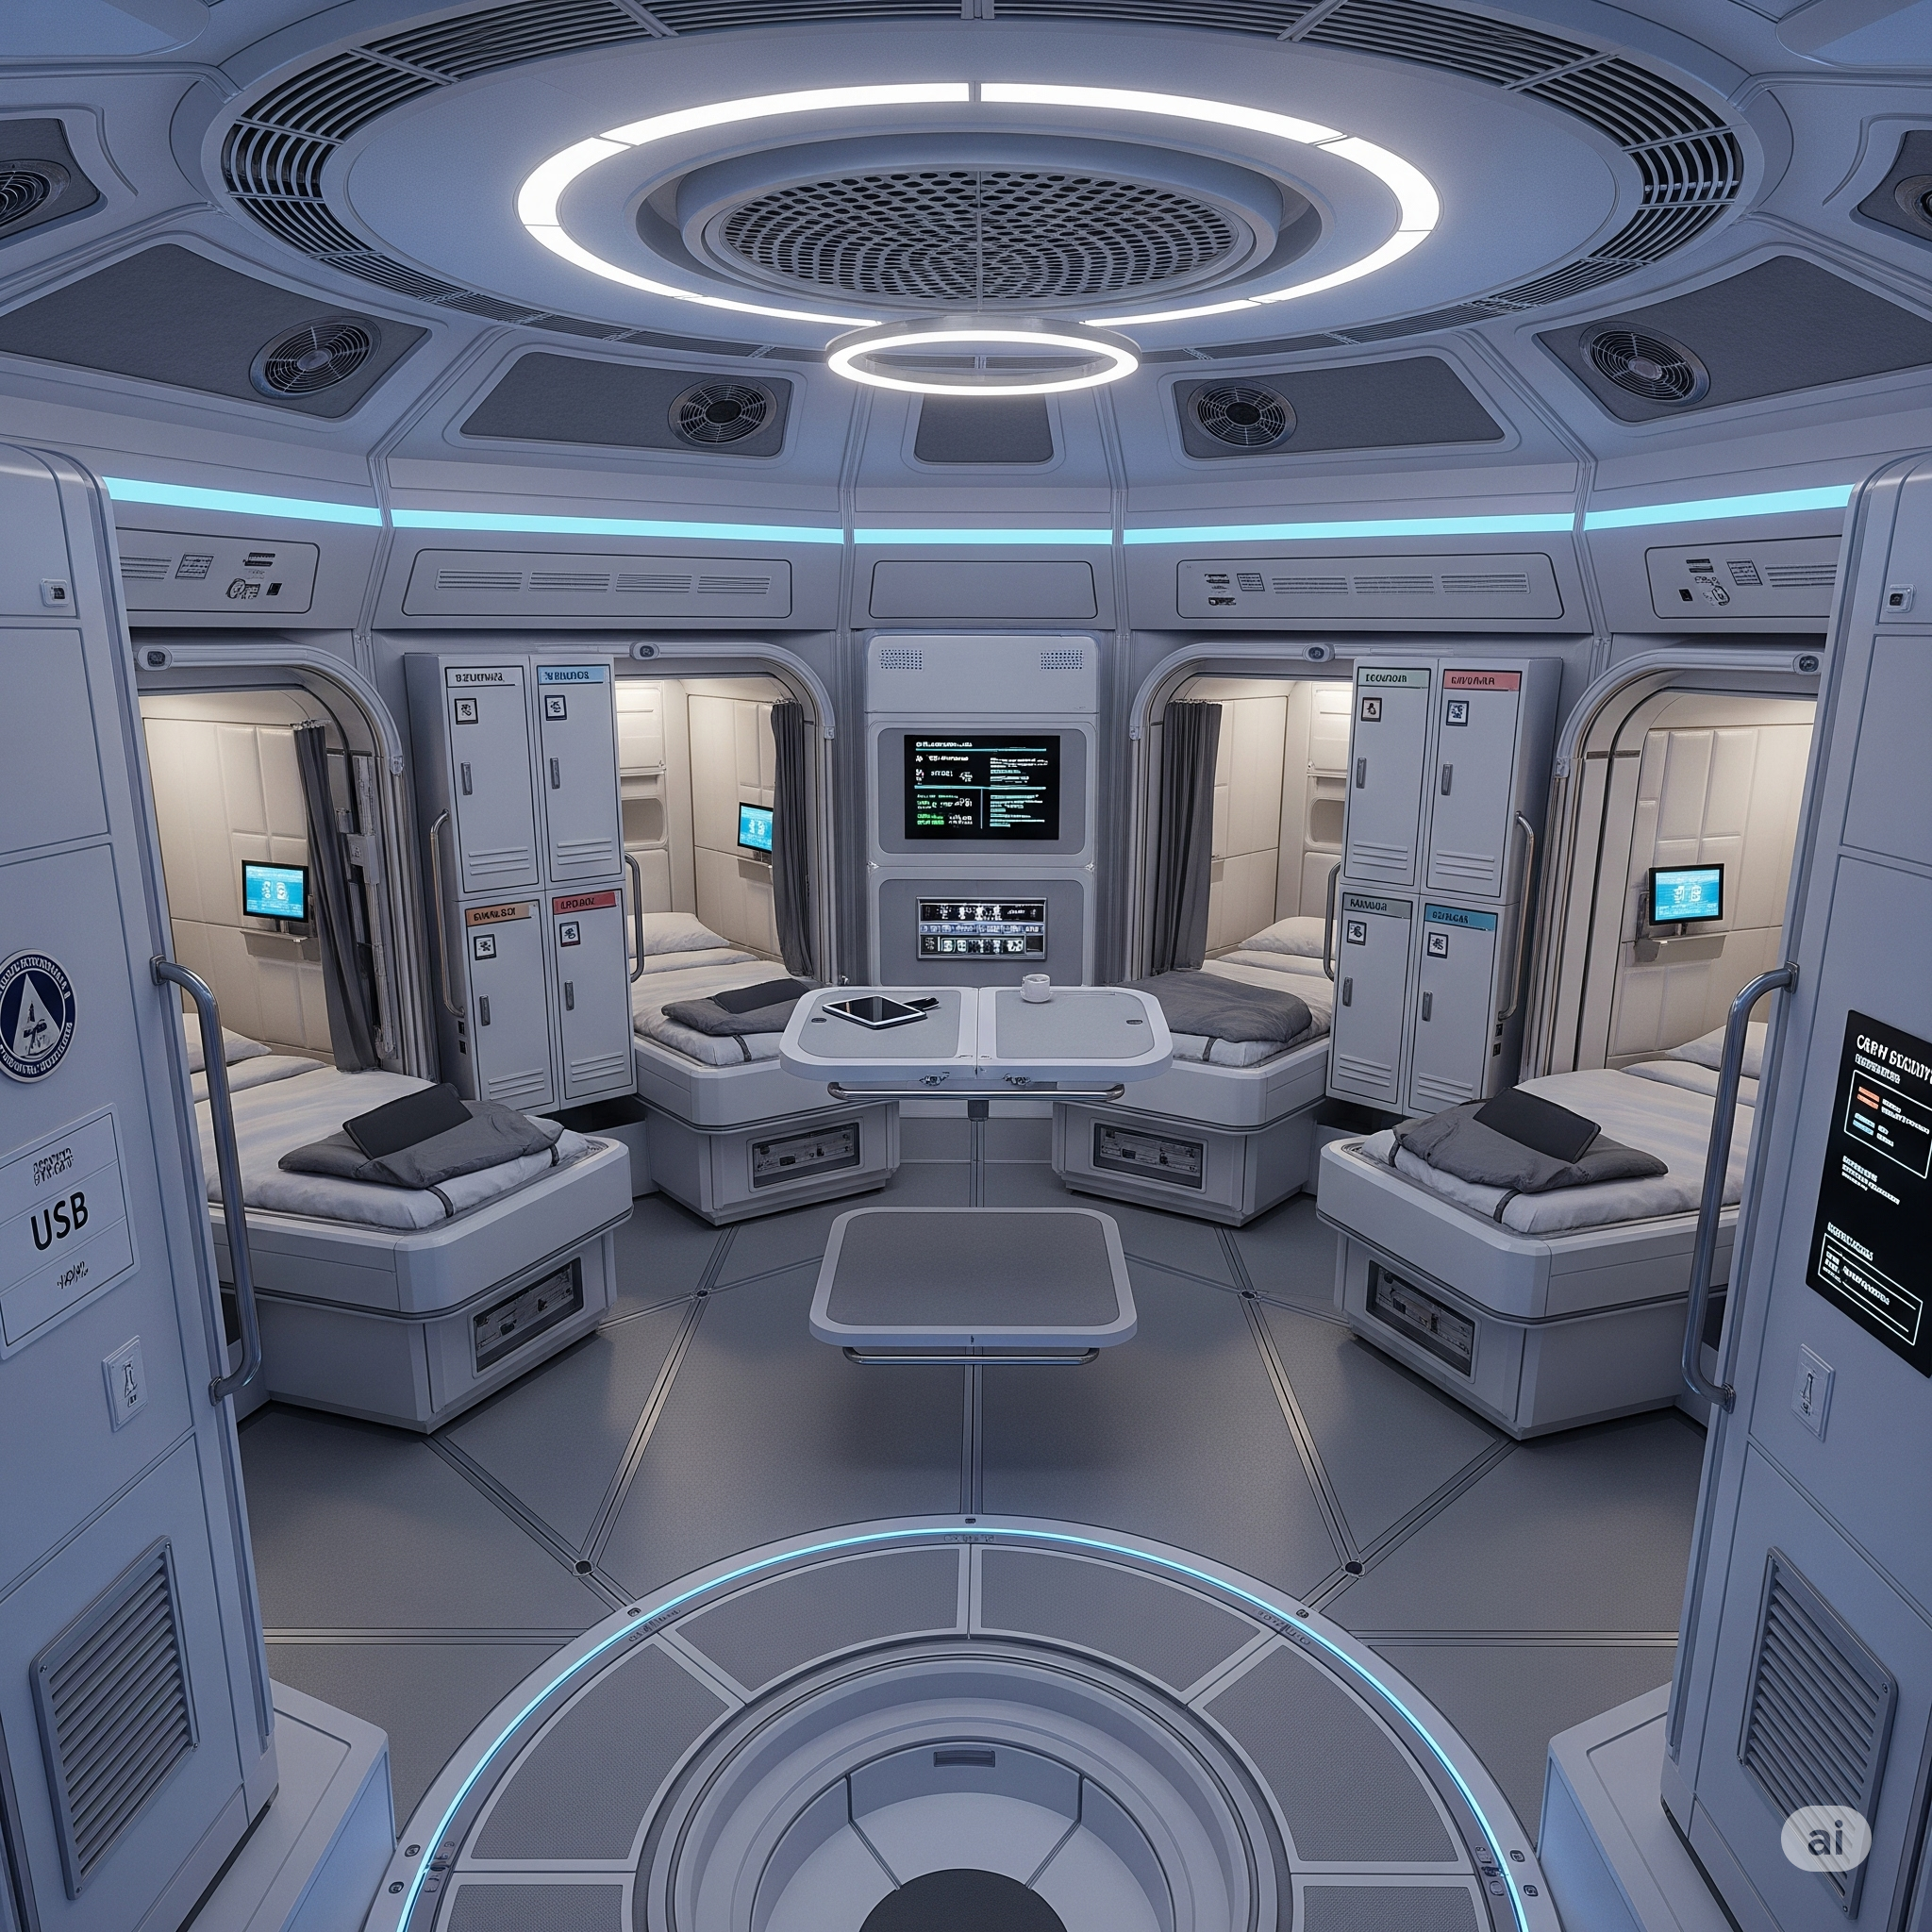
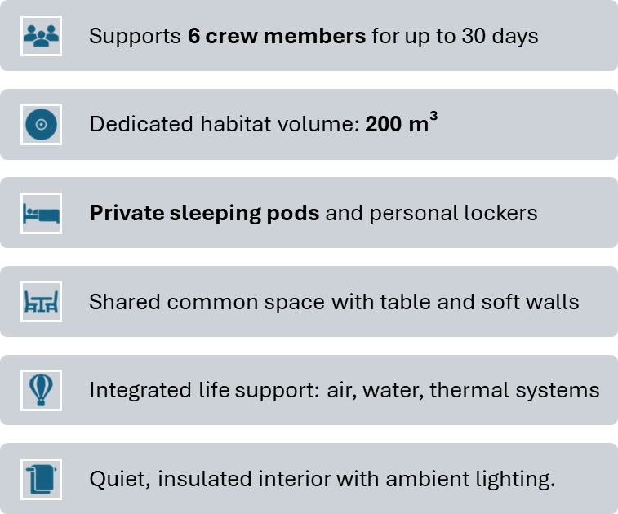
CREW SYSTEMS AND HABITABILITY

Slide 20
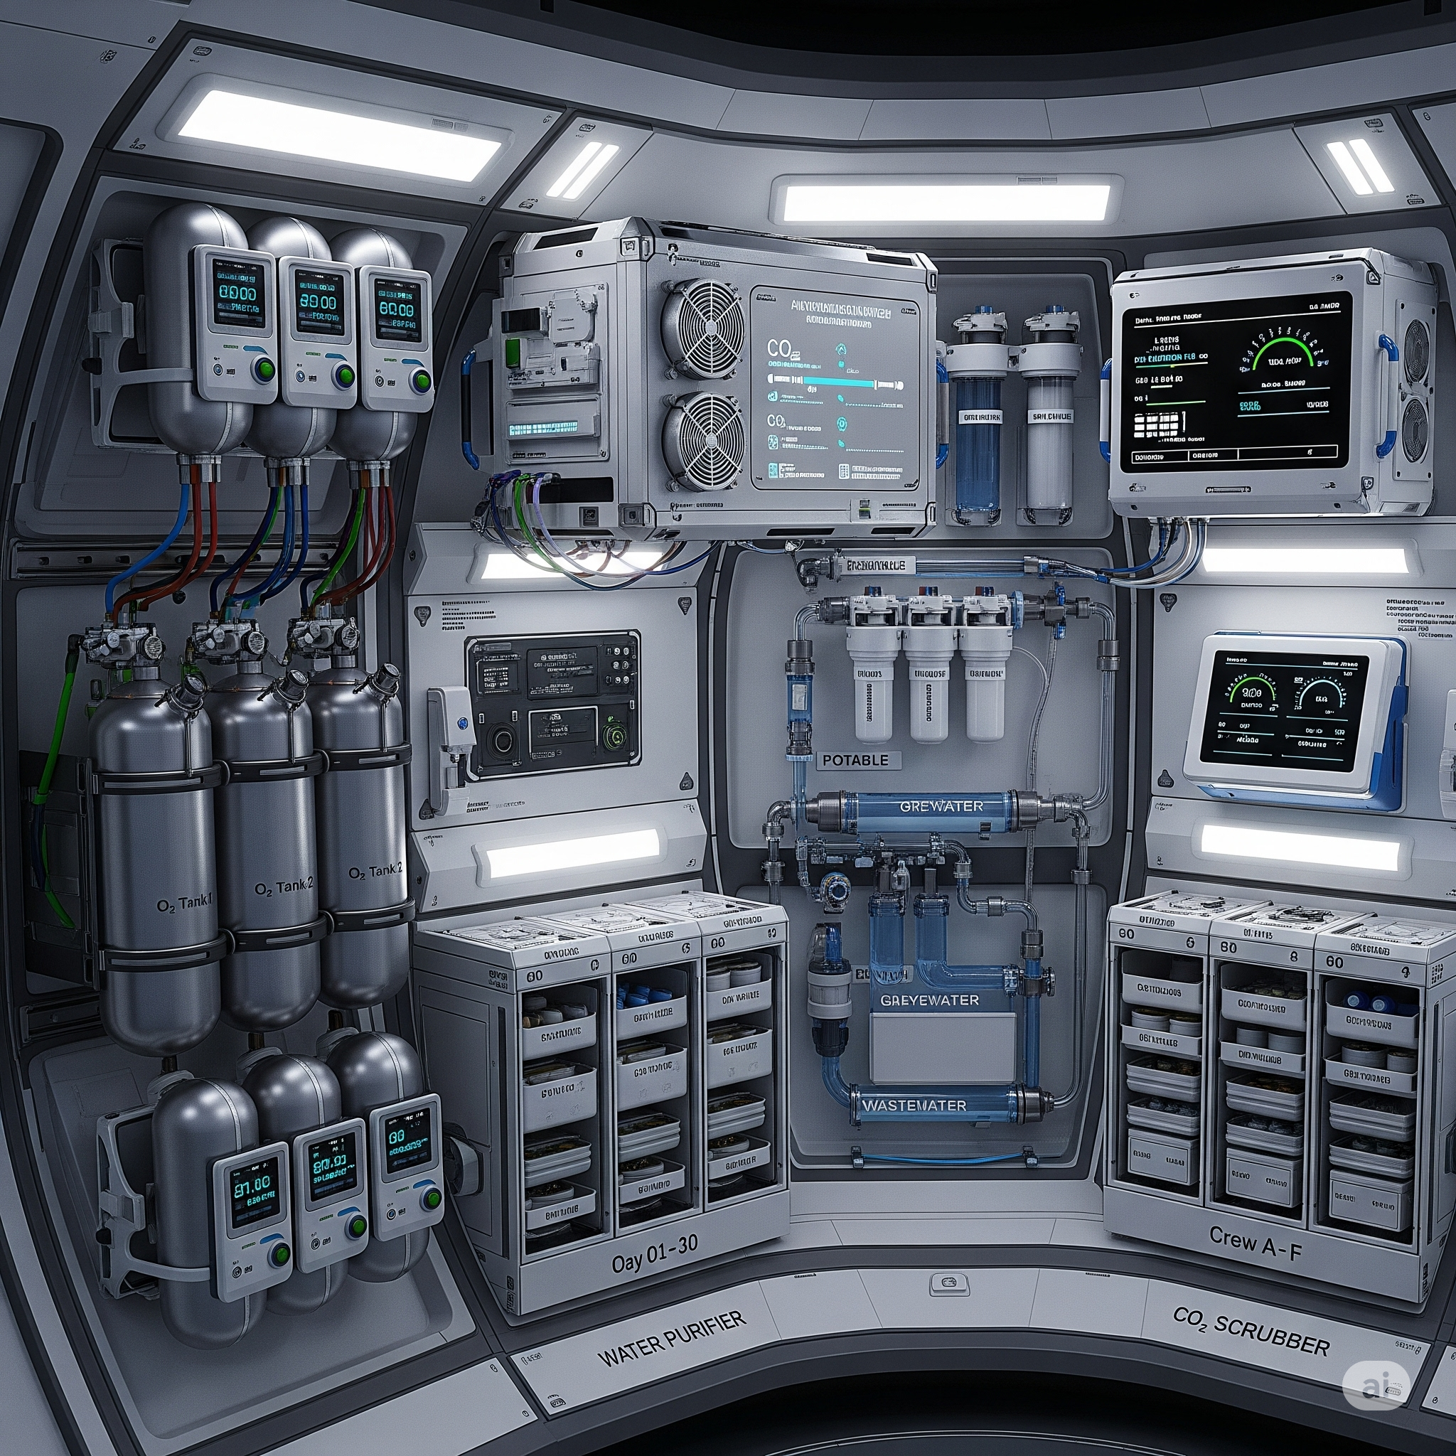
ENVIRONMENTAL CONTROLS AND CONSUMABLES
30-day support for 6 crew members
Estimated usage per mission: • Water: ~930 kg • Food: ~150 kg • Oxygen: ~150 kg
Integrated CO₂ scrubbing and air recycling
Water purification and greywater recovery loop
Systems housed in life support zone (Deck 4)
Monitored via internal health & air quality sensors, ECC.
Built-in redundancy and Backup air revitalization in deck-5.

Slide 21
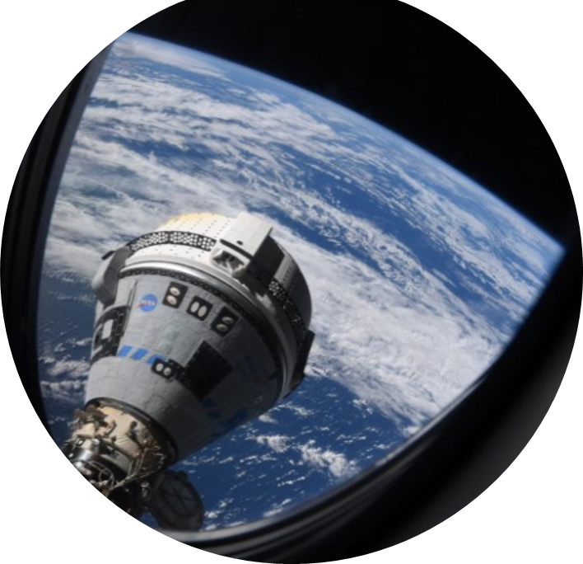
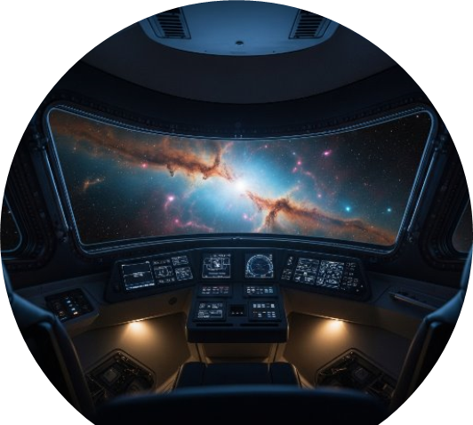
Structural Features & Panoramic Windows
Outer shell: pressurized space graded alloy
Reinforced with internal ribs for impact protection.(Circular support rings)
Panoramic windows
Material: transparent aluminum / polycarbonate
Framed for radiation shielding and thermal stability
Enhances crew visibility and psychological comfort
Circular portholes on deck 1 and 5.

Slide 22
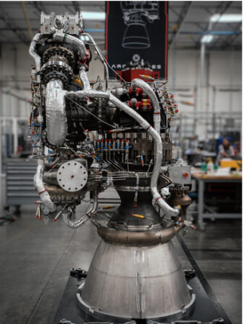
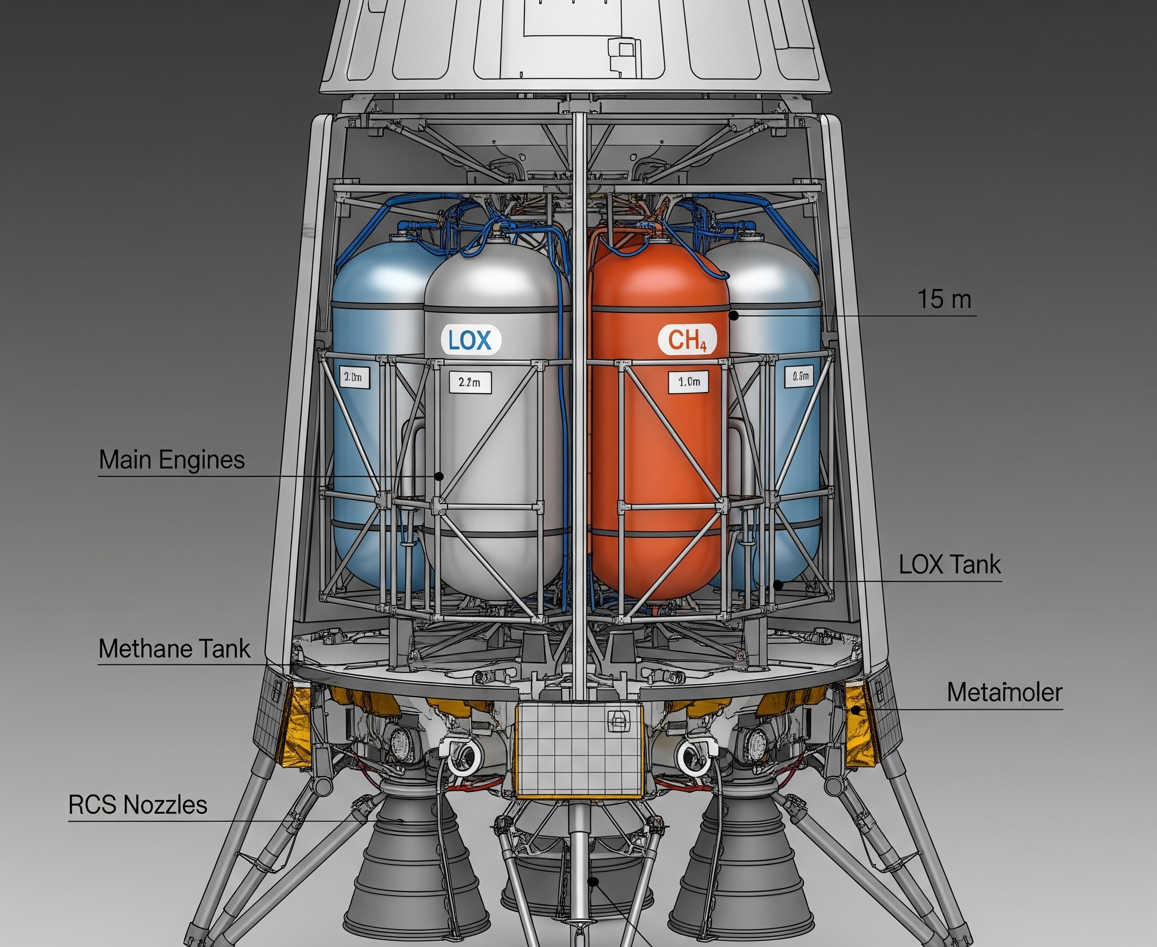
PROPULSION AND LANDING SYSTEM
Propulsion architecture(mission lifecycle)
Required Δv: ~3,600–3,800 m/s (total)
Propellant mass: ~22.2 tons (CH₄ + LOX)
CH₄ tank: 3 m diameter × 1.76 m height
LOX tank: 3 m diameter × 2.10 m height
Tanks placed low for center of gravity optimization
Engine setup: 4 engines, ~43.4 kN each
Total thrust: ~173.6 kN
Engine type: Methalox, throttle-capable
Located below tanks to optimize CG & thrust alignment
Landing system: 4 retractable, shock-absorbing legs

Slide 23
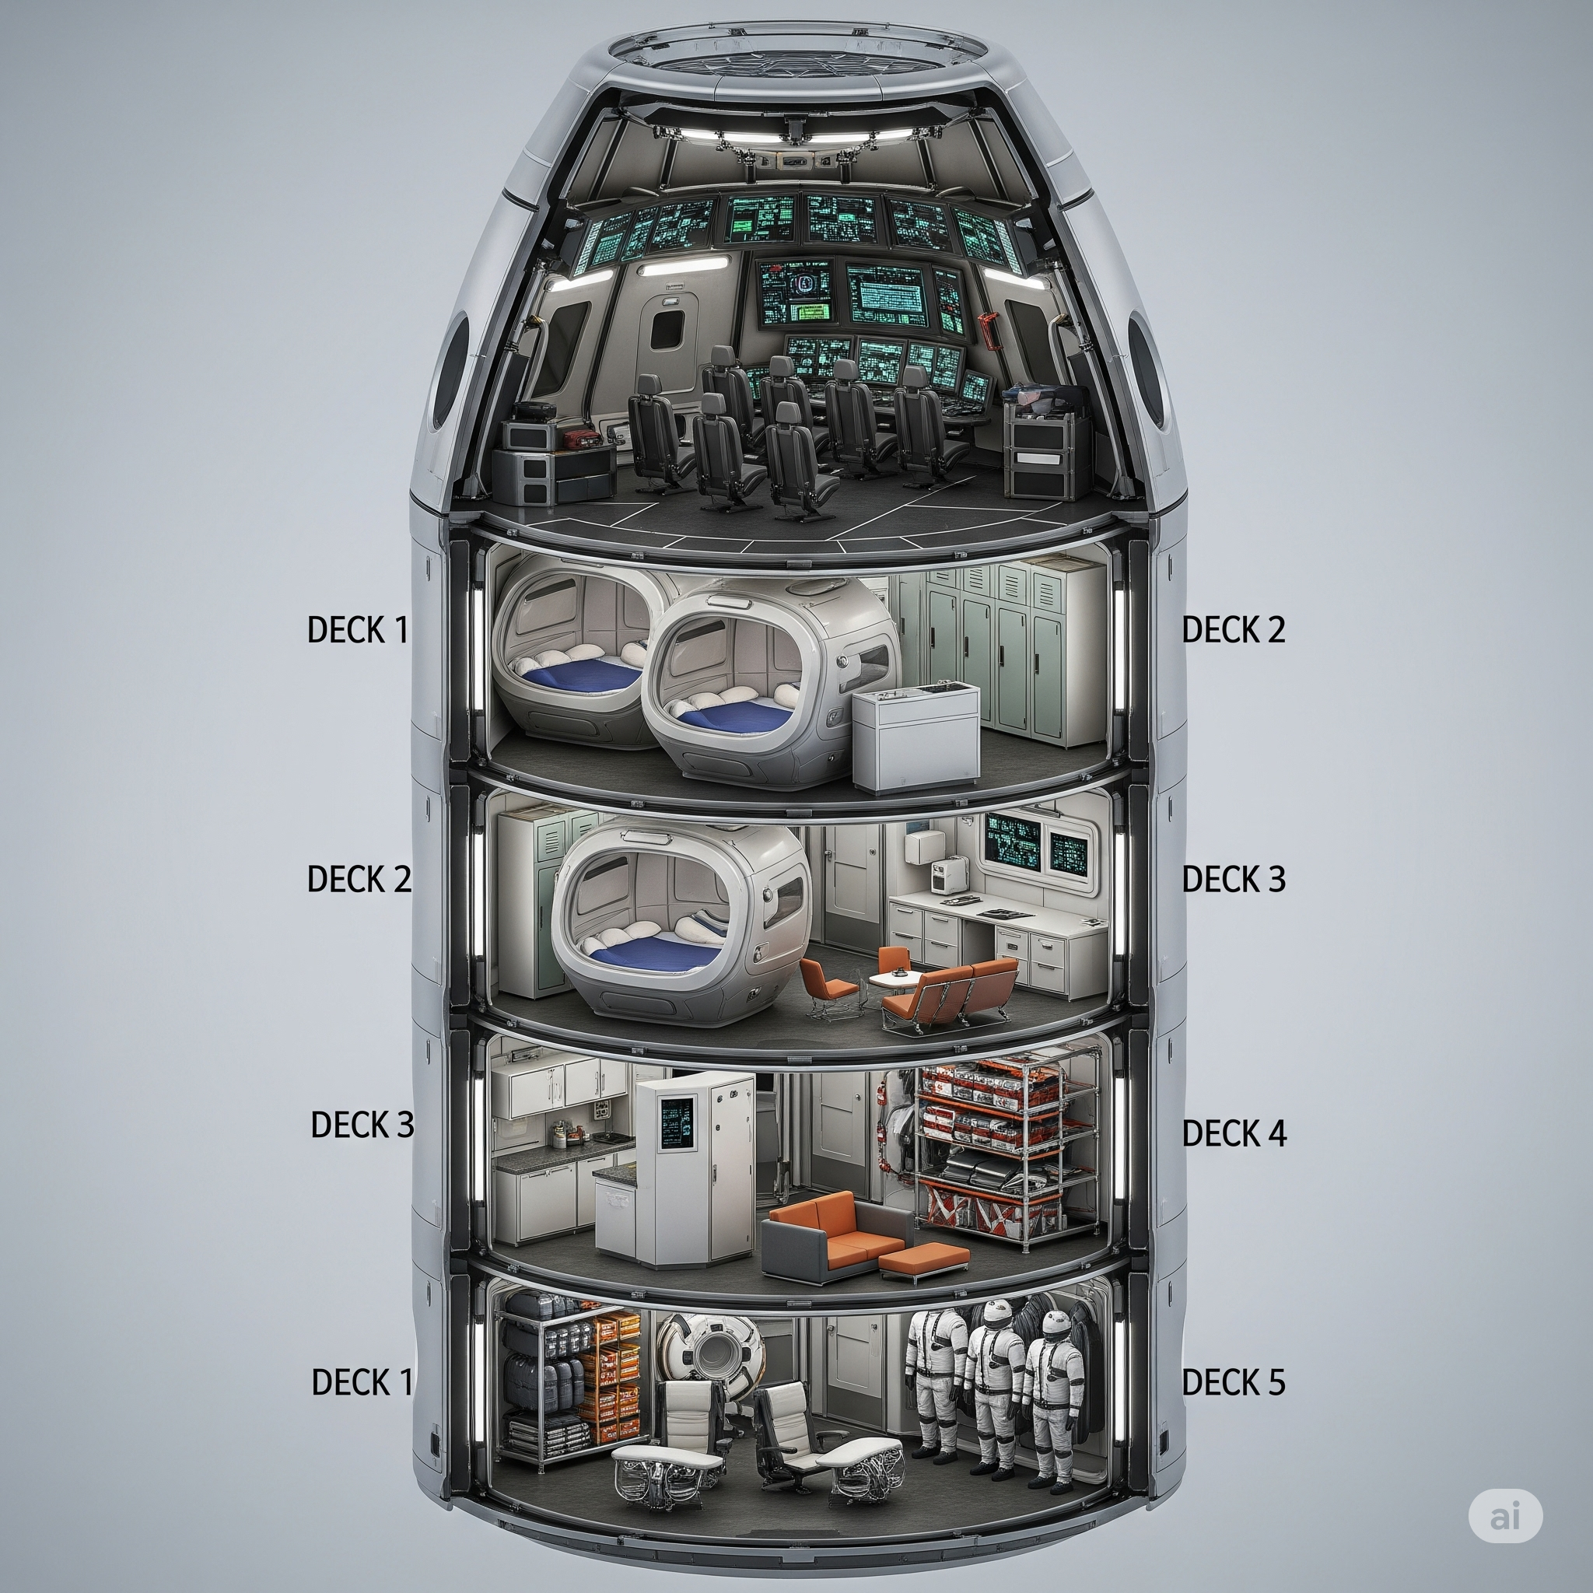
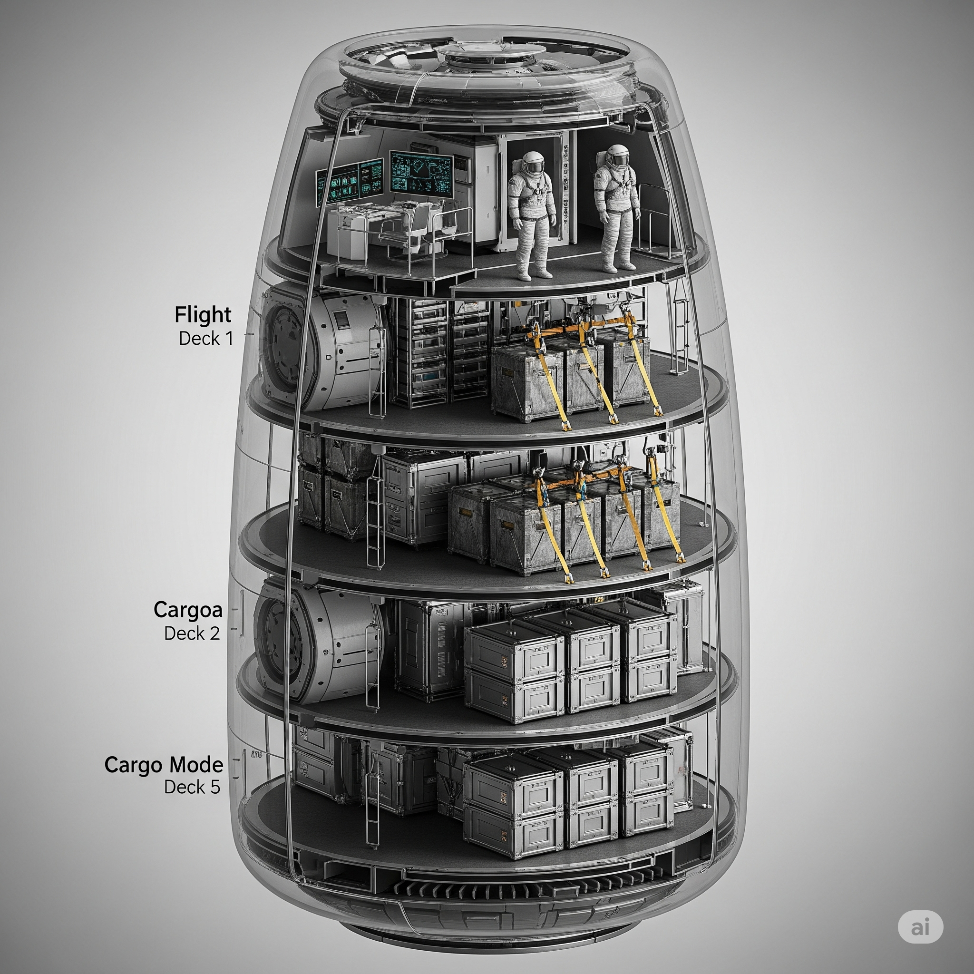
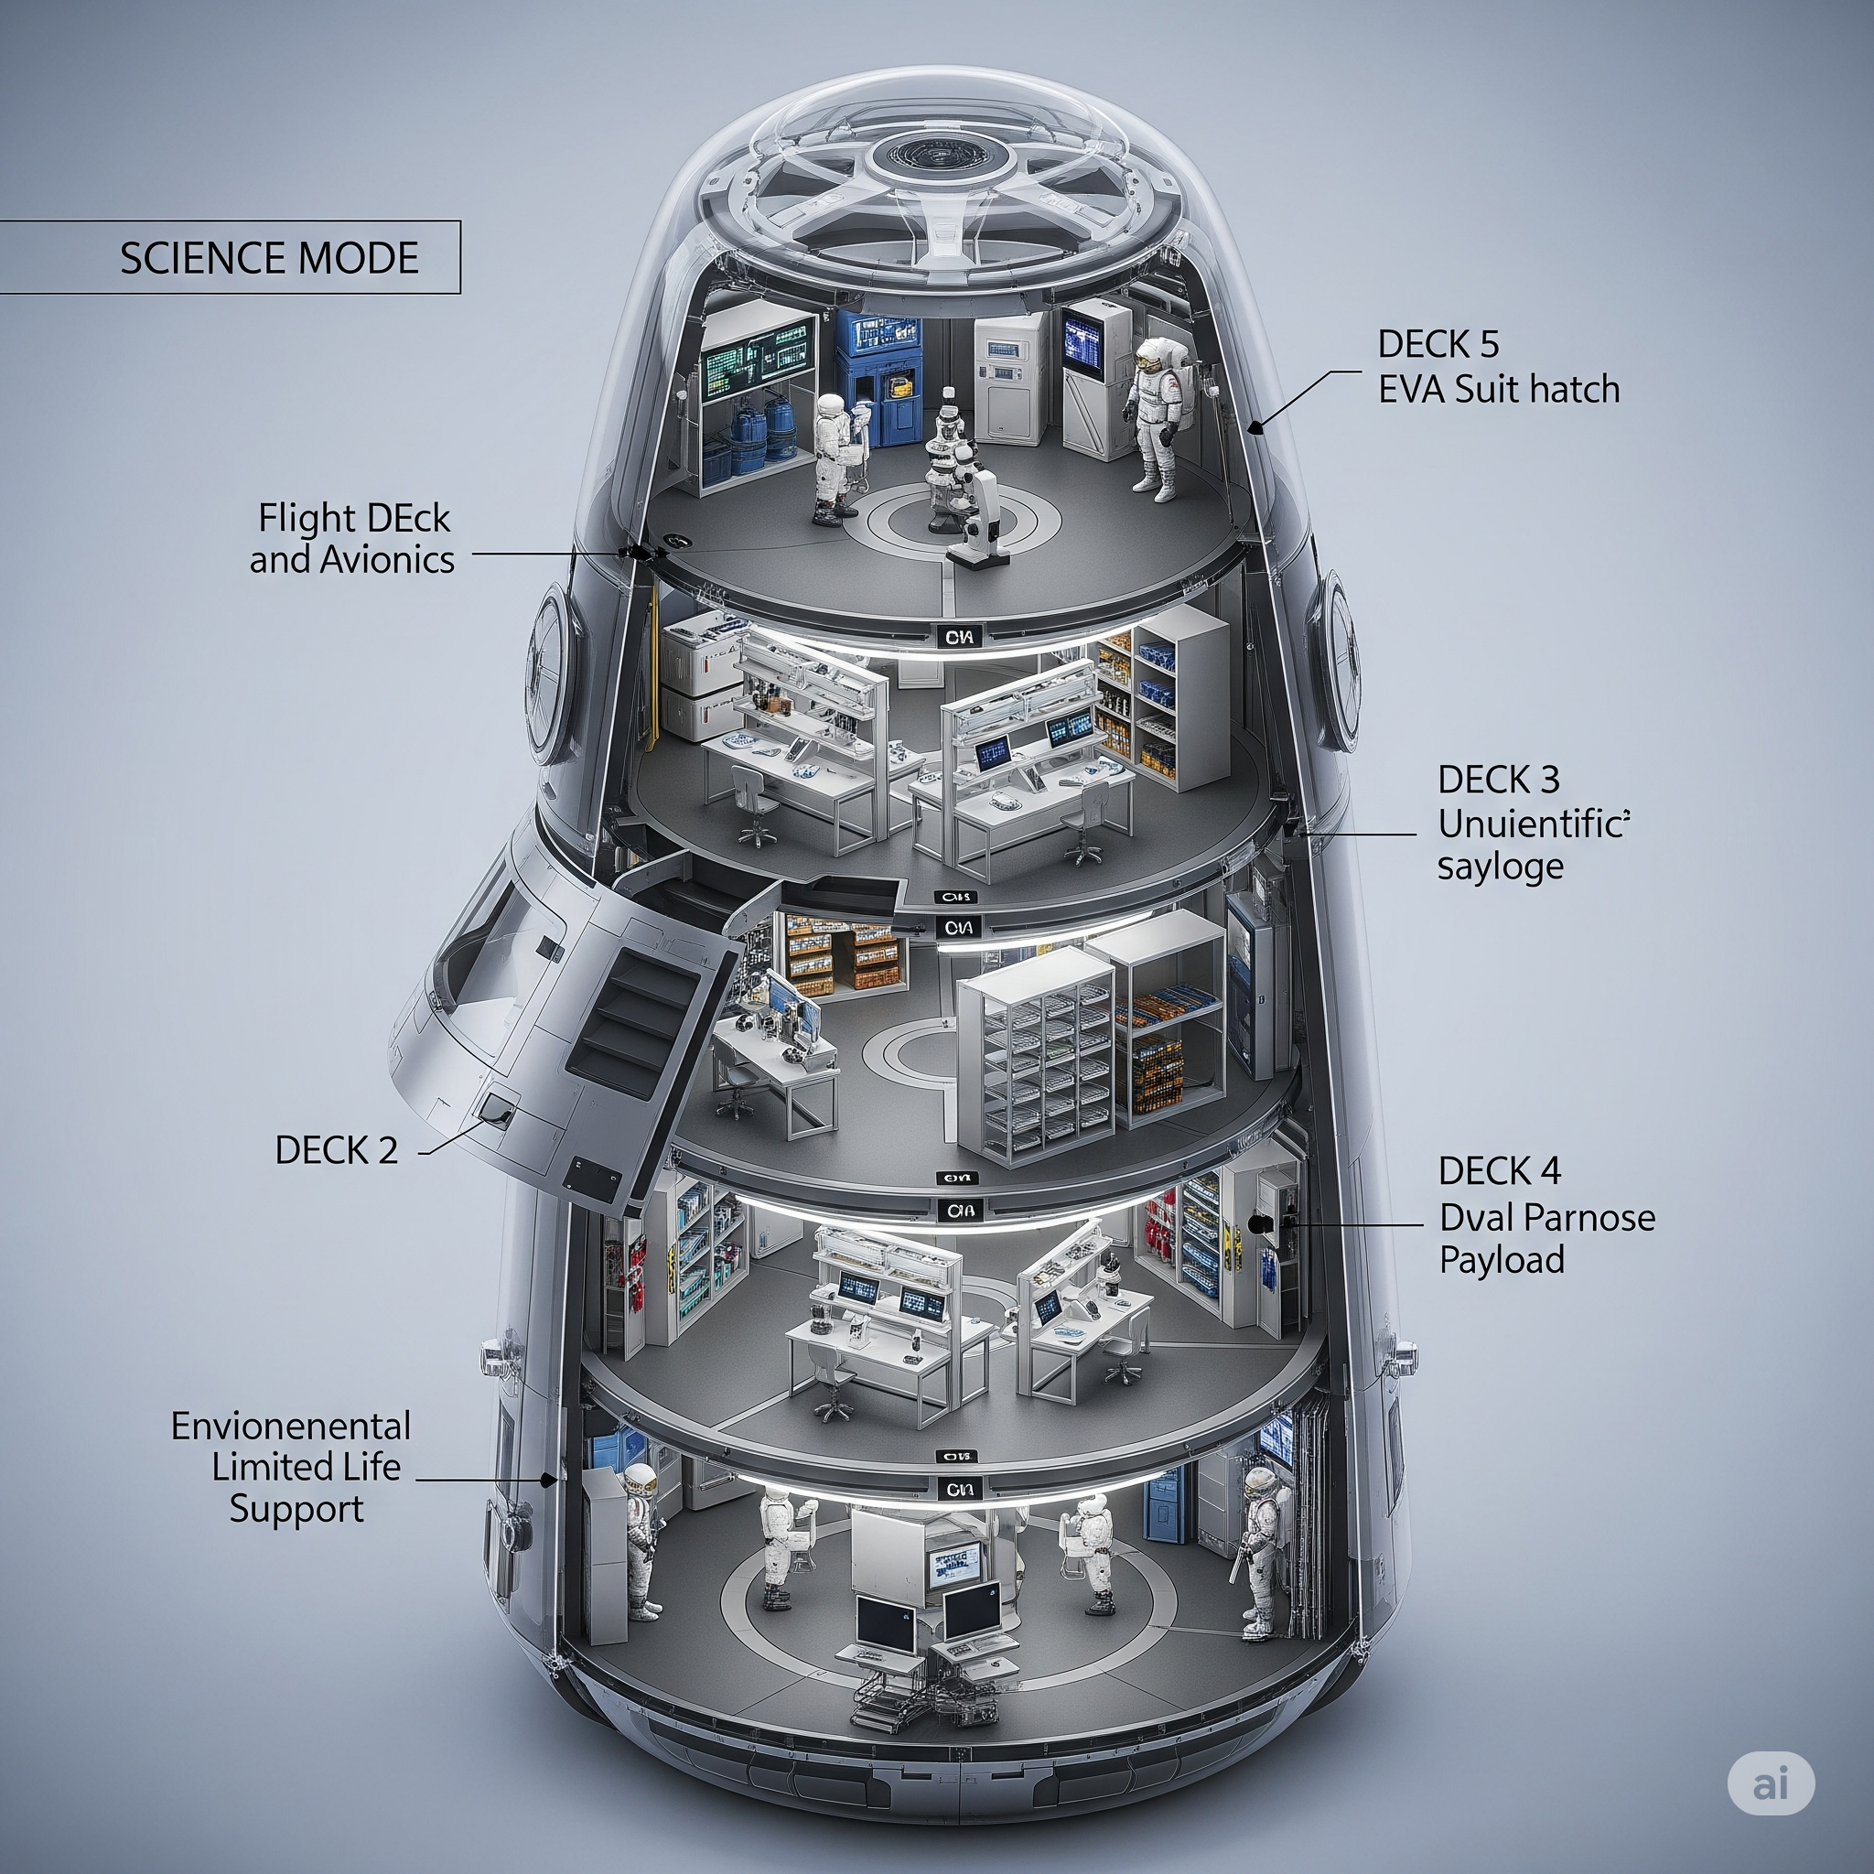
POD MODULARITY AND FLEXIBILITY
Interior uses modular racks and floor panels(rail mounts)
Easily reconfigurable(plug & play with sealed ports)
Systems remain fixed in base structure(Avionics,propulusion)
Reduces redesign time between missions
Supports long-term reusability and upgrades
Crewed missions (life support, bunks)
Cargo delivery (empty central volume)
Science missions (lab racks, instruments)

Slide 24

SUMMARY
Mission:
Defined the core lunar mission objectives, highlighted limitations of current ITS systems, and introduced the modular pod as a scalable solution to bridge the operational gap.
Strategic Business Vision:
Built the business case around modular deployment, mapped stakeholder involvement, and presented a multi-mission revenue strategy aligned with long-term exploration goals.
Technical Implementation: Delivered the engineering approach behind the pod: structural layout, life support integration, propulsion systems, and modular reconfiguration for mission flexibility.

Slide 25
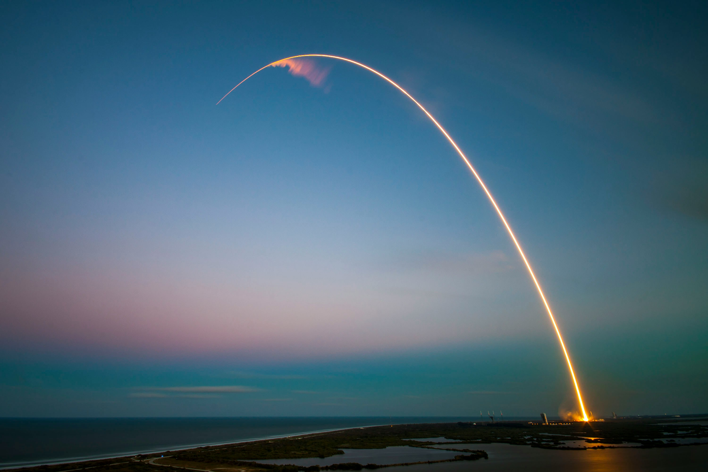
Shaping the Future of Interplanetary Travel

Slide 26
THANK YOU

